Slide 1


Slide 2
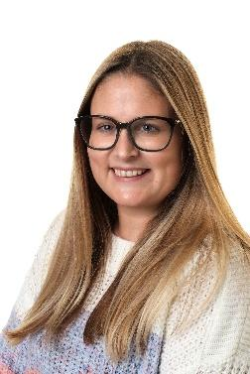
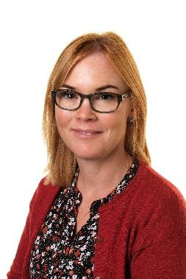
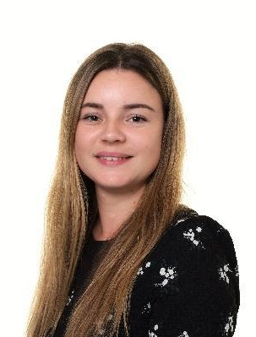
Nursery Staffing Structure September 2025
Early Years Lead - Mrs Nugent
Nursery Teachers
Mrs Pigg (Monday&Tuesday) and Mrs Cox (Wednesday-Friday)

Slide 3
Stay and Play and Meet the Teachers
Thursday 17th July 9.30am-10.30am. This is a chance to see the Nursery setting and meet the Nursery Staff. There will be a mixture of full time and part time children at this session.
You will all have a one to one session on either Wednesday 3rd or Thursday 4th September.
On Friday 5th September you will join your child for a session in Nursery and we will be having a rhyme time session.

Slide 4

Nursery
Main focus are the Prime Areas -
Communication, PSED and Physical.
The children will have mini topics to find out more about the world around them.
We have key group time daily and this will either be with your child’s assigned key person or the Nursery Teacher.
We have an Early Excellence approach where children lead their play and make choices about what they want to do - a variety of resources are made available and adults support their learning and play.

Slide 5
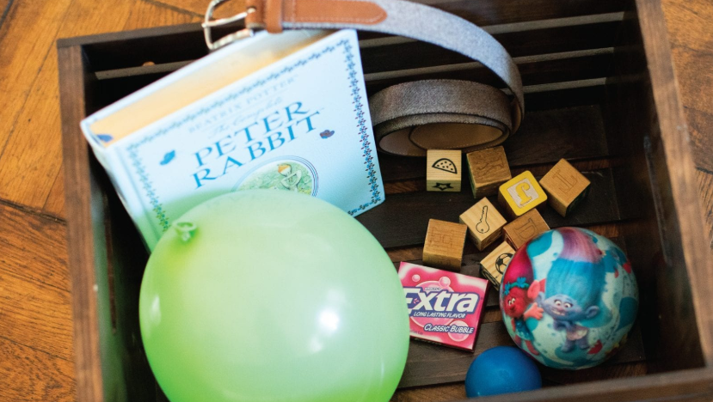

Maths and Phonics
The children will take part in phonics sessions
during the week with a focus on Phase 1
We follow the Supersonic Phonic friends scheme
but we do not introduce any grapheme to phoneme correspondence in Nursery.
They will listen to stories and learn Nursery Rhymes as part of their Literacy sessions.
There are daily maths sessions that may
include number songs, counting games and
practical activities involving shape space and
measures. We follow the White Rose Maths Scheme which prepares the children for Maths in Reception.

Slide 6
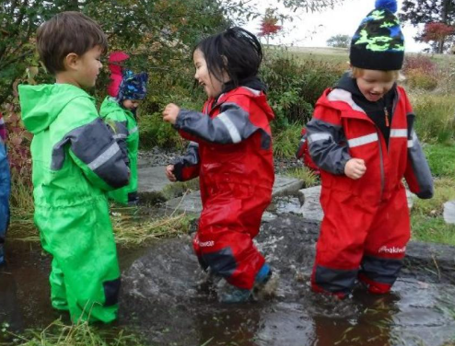
Outdoor Learning
We use the outdoor area in all weather
conditions so and they may get muddy,
sandy or wet if they are exploring.
We would like all children to have a waterproof coat trousers for outdoor play, and a pair of wellies. These should be a set that can be kept in Nursery as we have plenty of storage for these.
All children should also have a full change of clothes that can be kept at Nursery too.

Slide 7

What else will they need?
A drink bottle so that they can go and access a
drink at any time. We do provide milk and
water at snack time.
A book bag - the traditional book bags are the best option as they keep books flat and don’t damage the edges. They are also much easier to store in the coat peg area.
If your child requires a bag with spare clothes or nappies daily this can be in a small backpack which we can store in our cloakroom area.

Slide 8
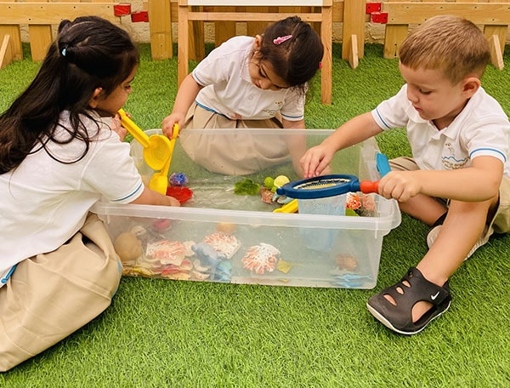
Our school Behaviour and Attendance Policies
Our behaviour and attendance policies are on our school website.
Our behaviour policy follows a
therapeutic approach and focuses on
teaching children about pro-social
behaviour and managing feelings.
This is one of the Prime Areas of the
Early Year Curriculum and one that we
feel is key to their overall development.

Slide 9
Staggered Starts
 | Monday 4th September | Tuesday 5th September | Wednesday 6th September | Thursday 7th September | Friday 8th September
Morning | NPD | NPD | 1-1 parent meetings | 1-1 parent meetings | Stay and Play 8.30am-9.30am
Afternoon |  |  |  |  | 1.00pm-2.00pm
 | Monday 11th September | Tuesday 12th September | Wednesday 13th September | Thursday 14th September | Friday 15th September
Morning | 8.30am-10am | 8.30am-10am | 8.30am - 10.30am | 8.30am-11am | 8.30am-11.30am Normal Nursery time
Afternoon | All 1.00pm-2.30pm | All 1.00pm-2.30pm | All 1.20pm-3.20pm | All 12.50pm-3.20pm | All 12.20pm-3.20pm Normal Nursery Hours

Slide 10
Normal Nursery Sessions from Friday 15th September
Morning session 8.30am-11.30am (The Nursery Gate closes prompt at 8.35am)
Afternoon session 12.20pm-3.20pm (The Nursery Gate closes prompt at 12.25pm)

Slide 11
Nursery Snack
This is a big part of our Nursery day as it allows children to try new foods, learn new skills and be more independent. It is a really social time for the children.
We provide the snack at the cost of £1 per week. This is payed through our ParentPay app. The payment will be set for the term. We will also use the monies collected to provide cooking opportunities.

Slide 12
Uniform
Comfort and independence are key.
Jogging bottoms and leggings are more practical that tailored trousers or skirts/dresses. They spend a lot of time on the floor and being busy.
White Polo shirt and grey jumper. You can purchase these with the school logo if you wish
All children must also have waterproof clothing and wellie boots.

Slide 13
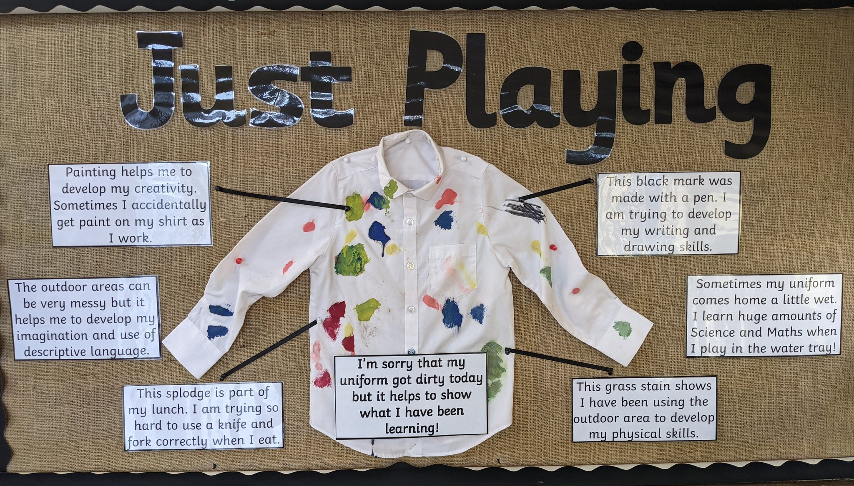

Slide 14

Uniform
The Uniform shop can be found on Timberlog lane - details in your booklet.
There is also the Laindon School Uniform Bank.
We cannot promise uniform will stay clean as learning is a messy business sometimes!

