Slide 1


Slide 2
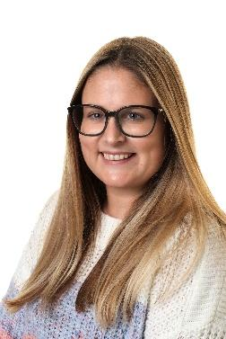
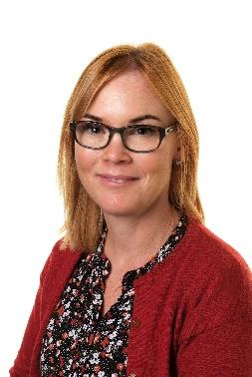
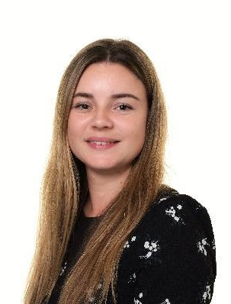
Nursery Staffing Structure September 2025
Early Years Lead - Mrs Nugent
Nursery Teachers
Mrs Pigg (Monday&Tuesday) and Mrs Cox (Wednesday-Friday)

Slide 3
Stay and Play and Meet the Teachers
Thursday 17th July 9.30am-10.30am. This is a chance to see the Nursery setting and meet the Nursery Staff. There will be a mixture of full time and part time children at this session.
You will all have a one to one session on either Wednesday 3rd or Thursday 4th September.
On Friday 5th September you will join your child for a session in Nursery and we will be having a rhyme time session and some useful information on Listening and Attention skills.

Slide 4

Nursery
Main focus are the prime areas
Communication, PSED and Physical.
The children will have mini topics to find out more about the world around them.
We have key group time daily and this will either be with your child’s assigned key person or the Nursery Teacher.
We have an Early Excellence approach where children lead their play and make choices about what they want to do - a variety of resources are made available and adults support their learning and play.

Slide 5
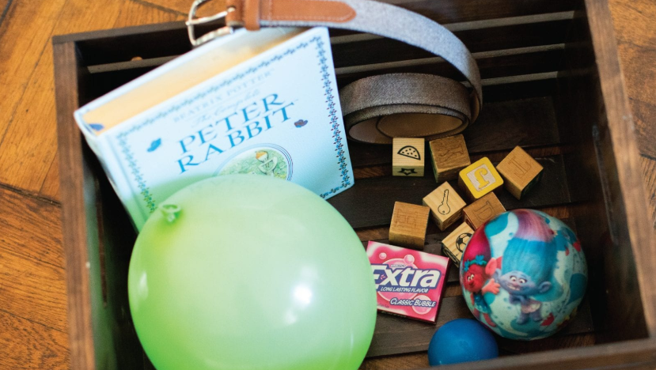

Maths and Phonics
The children will take part in phonics sessions
during the week with a focus on Phase 1
We follow the Supersonic Phonic friends scheme
but we do not introduce any grapheme to phoneme correspondence in Nursery.
They will listen to stories and learn Nursery Rhymes as part of their Literacy sessions.
There are daily maths sessions that may
include number songs, counting games and
practical activities involving shape space and
measures. We follow the White Rose Maths Scheme which prepares the children for Maths in Reception.

Slide 6
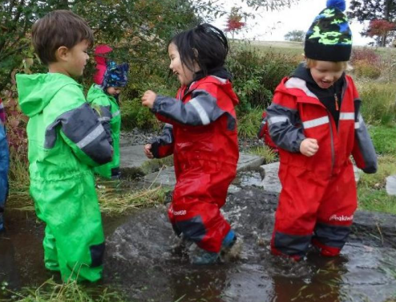
Outdoor Learning
We use the outdoor area in all weather
conditions so and they may get muddy,
sandy or wet if they are exploring.
All children should have a waterproof coat trousers for outdoor play, and a pair of wellies. These should be a set that can be kept in Nursery as we have plenty of storage for these.
All children should also have a full change of clothes that can be kept at Nursery too. This can be in a PE type bag and we will send it home if items need replacing.

Slide 7
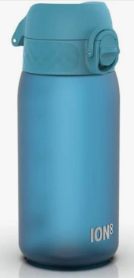
What else will they need?
A drink bottle so that they can go and
access a drink at any time. We do provide
milk and water at snack time.
A book bag - the traditional book bags are the best option as they keep books flat and don’t damage the edges. They are also much easier to store in the coat peg area.
If your child requires a bag with spare clothes or nappies daily this can be in a small PE style bag which we can store in our cloakroom area.

Slide 8
Staggered Starts
 | Monday 4th September | Tuesday 5th September | Wednesday 6th September | Thursday 7th September | Friday 8th September
Full Time | NPD | NPD | 1-1 parent meetings | 1-1 parent meetings | Stay and Play 10.00am-11.00am
 | Monday 11th September | Tuesday 12th September | Wednesday 13th September | Thursday 14th September | Friday 15th September
Full Time | 10.15-11.45am | 9.00am-11.45am | 10.00am -2.30pm (stay for lunch) | 9.30am -3.20pm | 8.30am-3.20pm

Slide 9
Normal Nursery Sessions from Friday 15th September
Doors open at 8.30am-8.35am. We will close the gate promptly at 8.35am
They have a 50 minute lunch break from 11.30-12.20 - you can book a school lunch for £2.00 a day through Parentpay or they can have a packed lunch.
The afternoon session finishes at 3.20pm.

Slide 10
Nursery Snack
This is a big part of our Nursery day as it allows children to try new foods, learn new skills and be more independent. It is a really social time for the children.
We provide the snack at the cost of £1 per week. This is payed through our ParentPay app. The payment will be set for the term. We will also use the monies collected to provide cooking opportunities.

Slide 11
Uniform
Comfort and independence are key.
Jogging bottoms and leggings are more practical that tailored trousers or skirts/dresses. They spend a lot of time on the floor and being busy.
White Polo shirt and grey jumper. You can purchase these with the school logo if you wish
All children must also have waterproof clothing and wellie boots.

Slide 12

Uniform
The Uniform shop can be found on Timberlog lane - details in your booklet.
There is also the Laindon School Uniform Bank.
We cannot promise uniform will stay clean as learning is a messy business sometimes!

Slide 13


