Slide 1


Slide 2
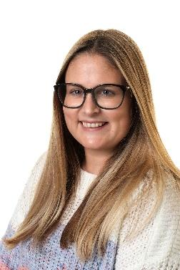
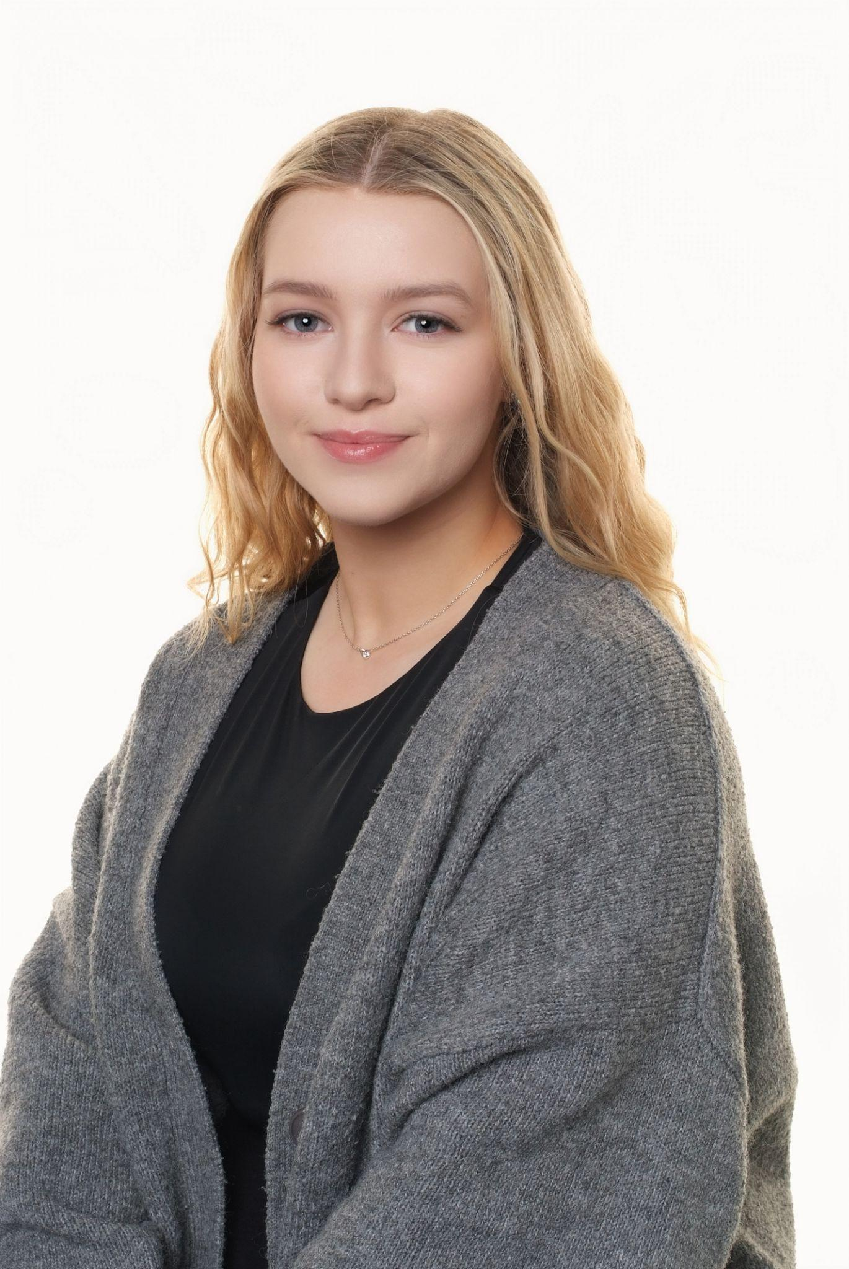
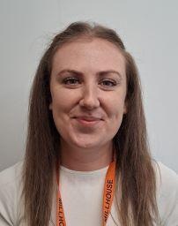
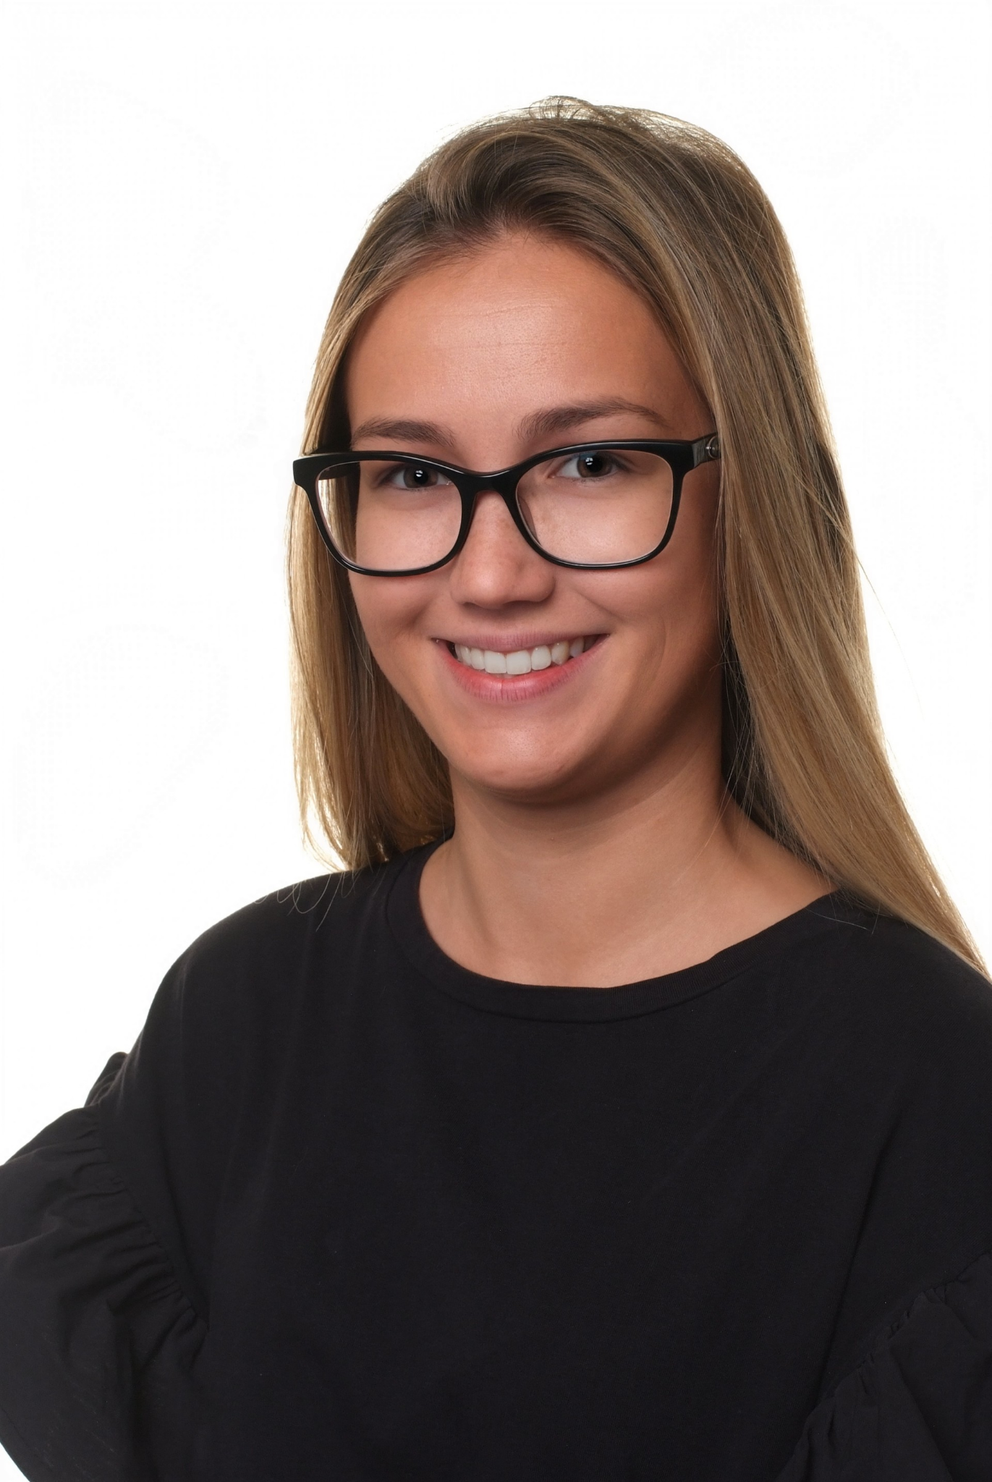
Staffing Structure for Reception
September 2025
Early Years Lead - Mrs Nugent
Class teachers
Class 1 Miss Percival | Class 2 Miss Day | Class 3 Miss Short

Slide 3
Transition visits
Tuesday 1st July - Activity session with parents. You will have been invited to an am or pm session.
This session is all about early skills and we will be giving out some resources to have use at home.
Monday 7th/Tuesday 8th or Wednesday 9th - You have the opportunity to meet with your child’s teacher for a one to one meeting.
Thursday 17th July - meet the teacher session 9.30am-10.30am. This is a session where you will drop the children to class and they will stay for a short session to get to know their teachers and children in their class. The children will come in via the Tavistock Road gate.

Slide 4
Staggered Starts
Monday 1st September | Tuesday 2nd September | Wednesday 3rd September | Thursday 4th September | Friday 5th September
NPD | NPD | Group A 8.45-11.00 Group B 12.45-3.00 | Group B 8.45-11.00 Group A 12.45-3.00 | All in 8.45-11.30
Monday 8th September | Tuesday 9th September | Wednesday 10th September | Thursday 11th September | Friday 12th September
All 8.45-12.30 (Lunch) | All 8.45-1.30 | Normal Day | Normal Day | Normal Day

Slide 5
What is a typical day?
8.40 | Register, choose lunch and morning activity (the doors open at 8.35)
8.45 | Phonics – Supersonic Phonic friends
9.10 | Continuous provision – children explore and complete adult directed tasks
10.00 | Snack and story
10.20 | Maths – NCETM maths mastery and White Rose for shape space and measures
10.35 | Continuous provision – children explore and complete adult directed tasks
11.30 | Rhyme Time
11.45 | Lunch
12.45 | Dough Disco and Fine Motor activities
1.30 | Whole class input – usually Topic based – wondering about the World (this includes subjects such as Science, History, Geography and Art)
1.45 | Continuous provision – children explore and complete adult directed tasks
2.45 | Story and Milk
3.10 | Home time

Slide 6
Getting Prepared – school readiness
There has been a lot in the media about this recently
All children are at different places developmentally when they come to us in September – but here are a few things you can do to help.
Putting on their own shoes and coats – including doing up the zip.
Dressing and undressing – we can help with the tricky bits!
Going to the toilet by themselves and washing their hands.
Being able to ask for help – reassure them that grown ups in school are there to help.
Getting their things ready for school – what do they need. If they do this with you then they will be more independent at home time.
Using a knife and fork when eating their dinner.

Slide 7

What should they already know?
We have a great curriculum to help children learn to read, write and be numerate, as well and opening up their minds to new things.
To do this they should be able to:
Listen to a short story with you and talk about it.
Express their ideas – for example talk about something they liked on a day out.
Know some Nursery Rhymes and Number songs
Be able to recognise their name
Be curious!
Enjoy mark making
Be active.

Slide 8
What will they need?
A book bag - they should only bring the traditional book bag to school not a backpack.
A water bottle - this should only have water in it.
Waterproof coat and trousers or puddle suit, and wellies to stay in school (this is part of our EYFS school uniform)
A spare change of clothes - this can be kept in school in a PE type bag.

Slide 9
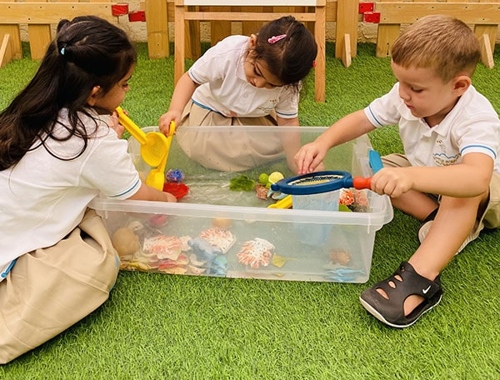
Our school Behaviour and Attendance Policies
Our behaviour and attendance policies are on our school website.
Our behaviour policy follows a
therapeutic approach and focuses on
teaching children about pro-social
behaviour and managing feelings.
This is one of the Prime Areas of the
Early Year Curriculum and one that we
feel is key to their overall development.

Slide 10
Baseline Assessment
You may have heard of the Baseline Assessment for Reception.
In the first couple of weeks all children will have a baseline assessment - this is a statutory assessment - it is completed on the computer and is just some fun activities that they complete with the teacher. It assesses Speech and Language, Early Reading and Maths skills.

Slide 11
After school Club
The school provides breakfast and after school clubs
Breakfast club from 7.30am - the must arrive no later than 8.15am (£3.50 per session).
After school club until 6pm (£8.50 per session). They can be picked up any time between 3.30pm and 6pm.
Places must be applied for and booked in advance.
Packs are available today. They must be returned by Monday 23rd June.

Slide 12

Uniform
The Uniform shop can be found on Timberlog lane - details in your booklet.
There is also the Laindon School Uniform Bank.
We cannot promise uniform will stay clean as learning is a messy business sometimes!

Slide 13
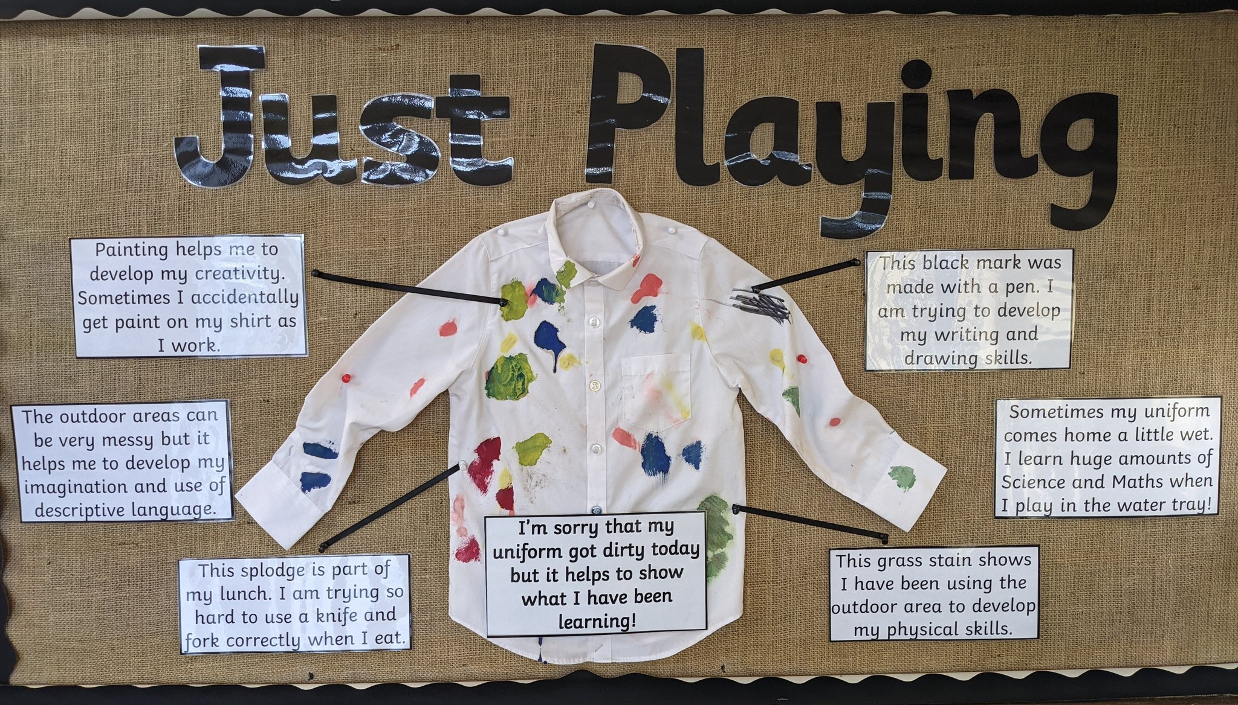

Slide 14


