Slide 1

Phonics and Early Reading and Writing

Slide 2
Phonological Awareness
Early phonological awareness/Phase 1 includes 7 elements that are vital before we introduce letter names and sounds.
Aspect 1 – Environmental sounds – this can include sound walks, adding sound effects to stories by talking about noises e.g. whoosh, crash. It also helps the children to be better at listening.
There are some great listening games for environmental sounds on YouTube. https://www.youtube.com/watch?v=Z2A6Ca_HZUQ
Aspect 2 – Instrumental sounds – being able to hear the difference in sounds, matching sounds, loud and quiet. You can do this at home with everyday items aswell, make your own shakers with rice or pom poms - do they sound the same?
Aspect 3 – Body percussion – passing the sound – a clap or a stamp, copying sounds, making sounds louder and quieter, following patterns, making compositions – rainstorm is coming, characters from stories – how would they walk?
Song ‘Hey hey look at me, I am clapping (replace the actions) can you see?’

Slide 3
Aspect 4 – Rhythm and Rhyme – can they listen to rhythms and copy. Rhyme – Nursery Rhymes and songs, rhyming pairs, silly soup, continuing a rhyming string – this can include nonsense rhymes (See next slide for Silly soup words)
Aspect 5 – Alliteration – matching items that have the same sounds, making up silly stories, alliterative names (You can go shopping for things beginning with s - sock, spider and ….you can give them the last one and they say it, make it harder by giving two options to choose from and then a challenge is to think of their own - they could even draw their own objects)
Aspect 6 – Voice sounds – boing like a ball, snake sssssss, quiet everyone ssssssssssshhhhhhhhhh, then beginning to segment – talk like a robot c-a-t and have a toy to match
Aspect 7 – Oral blending and segmenting – games like feed the robot cross the river and I spy with cvc words (a cardboard box with a slit cut in it to post pictures, a river can be some blue paper, a blue piece of material, or chalk it outside. They can jump over if they get it right.
This is the stage just before we introduce sounds – the whole of this Phase does not include any letter sounds being shown to the children.

Slide 4
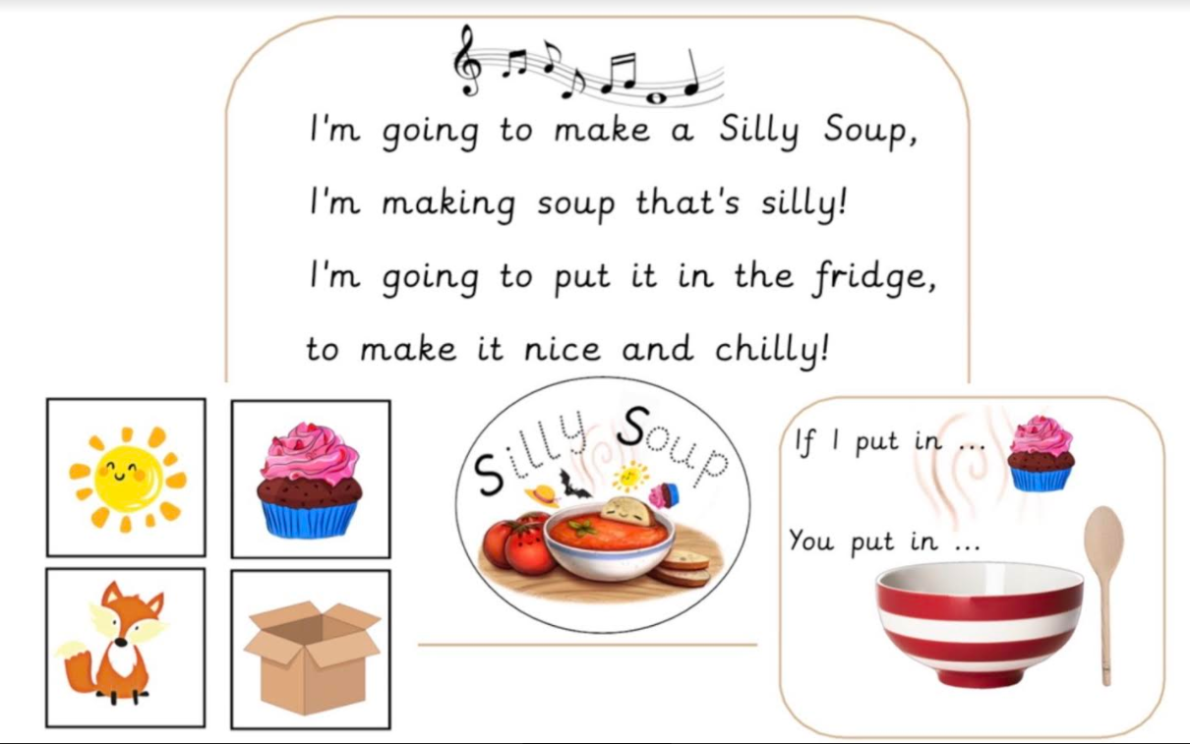

Slide 5
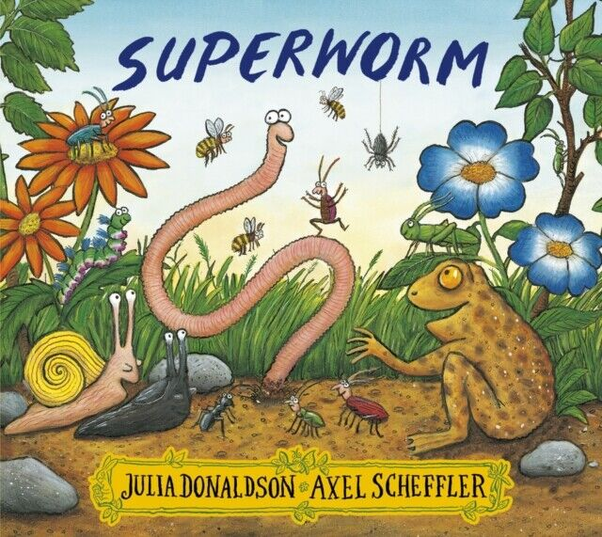
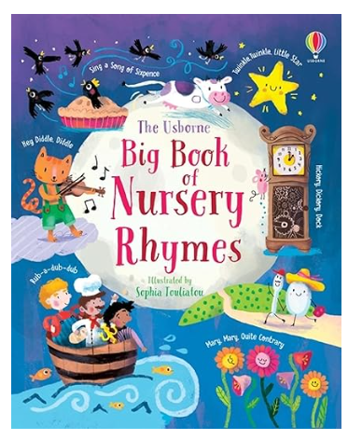
Rhyme Time
Rhythmical and rhyming books are brilliant.
Julia Donaldson has a rhyming structure
and good old fashioned Nursery Rhymes.
We have rhyme time in class each day and continue this with
poetry towards the end of the year.
TLC is a great essex based website for parents and has a great section on Rhymes.
https://www.tlc-essex.info/development-theme/literacy/

Slide 6
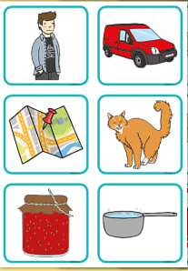
Oral blending and segmenting
This is when you have picture cards and no letters.
Blending - I can see a m-a-n (they then point to man)
If they find it hard then say I can see a m-a-n man,
can you say that with me m-a-n man - then they say it
on their own.
Segmenting - what sounds are in van - adult can say
v-a-n first if it is too hard, then together, van v-a-n and
then by themselves.

Slide 7

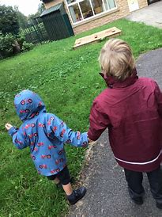
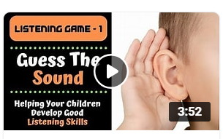
Phonics Journey in EYFS
We spend the first half term exploring and developing confidence in their Phase 1 knowledge and understanding.
We begin Phase 2 in the 2nd half of the Autumn Term. Phase 2 is hearing sounds, knowing the letter that matches that sounds and beginning to blend and segment.
Children may receive Phase 1 support alongside this and they are some easy games for you to play at home or while you are out and about. They may also be supported with Listening and Attention which is key to success in phonics.

Slide 8
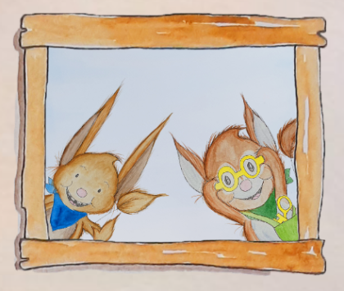
Our Phonics Programme
We use Supersonic Phonic Friends
This is a scheme which runs from Nursery to
Year 2
It has lots of fun characters, phrases and actions
to provide a multi sensory approach for the children.
Parents get a Newsletter emailed at the end of each Unit so you can keep up to date with your child’s learning.

Slide 9
How to pronounce sounds
It is important that children say the pure sounds and do not add a schwa on the end.
https://www.youtube.com/watch?v=K6qpaMrpits
Our phonics scheme also has some great actions and alliterations.
E.g. sss squishy strawberry
https://www.youtube.com/watch?v=Tlp7sAcP9Bg

Slide 10

Reading at home
Real books and scheme books will be sent
home. We will begin this on Friday with
real books and Lilac books.
Daily reading is encouraged – this can be you reading, paired reading, book talk or them reading.
They don’t always have to read the whole book – go at their pace.
As they learn new sounds the reading books will reflect this and you can practice the blending they have been doing in school.
Be patient – they are learning a new language with symbols they don’t yet understand.

Slide 11
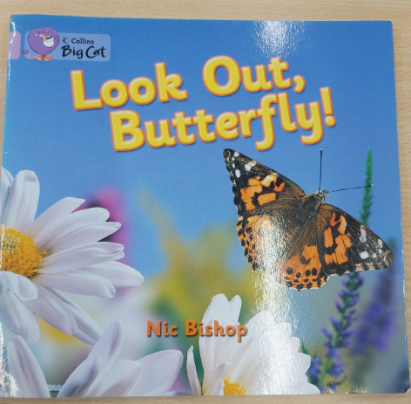
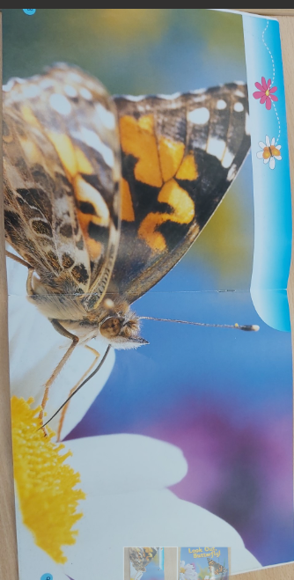
First Books - Lilac
Our very first ‘reading’ books do not have any words which may seem a little counter productive.
Reading skills such as prediction, comprehension and early inference can be developed here.
Great for Speaking and Listening even at a very basic level for naming vocabulary (nouns) and descriptive language (adjectives and verbs)
https://www.youtube.com/watch?v=TKJcDQNmumo

Slide 12
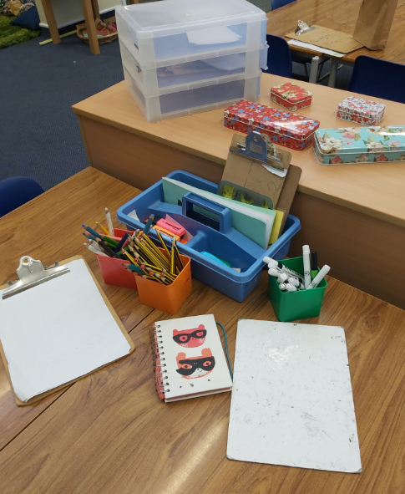
Early writing
Children will mark make before they begin to even use letters.
As there understanding of letters and phonics progresses so will their emergent writing.
Pencil control and fine motor skills are a big part of writing.
Good gross motor, balance and co-ordination is also vital.

Slide 13
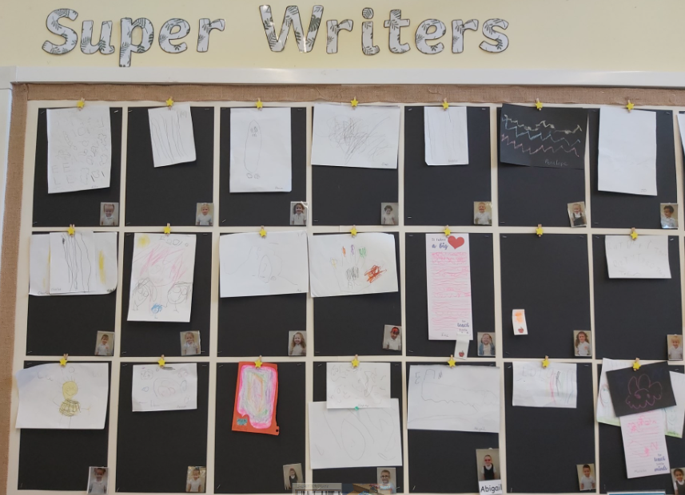
Celebrate their writing even if it doesn’t look like writing to you.

Slide 14
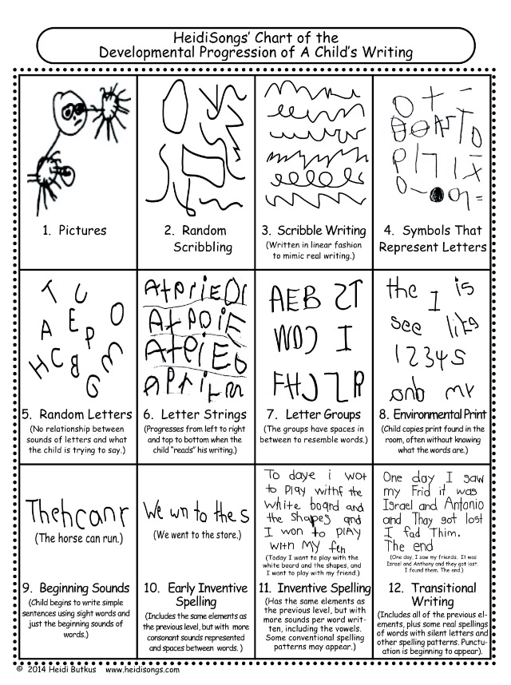

Slide 15
What’s Next?
Early morning reading will begin after half term – Wednesday 5th November – you can come in from 8.35am with the children and enjoy 15 minutes of reading. We will have some board books available for younger siblings to enjoy as well.
We are part of an exciting project called ‘Making it Real’ and we can offer a variety of support for parents. Please let me know what you would find most useful so we can tailor the programme.
Maths workshops will be held after Christmas to support with Maths in Early Years and you will be invited in to take part in some maths activities in class as part of this session.
This presentation will be available on the school website so you can access the links we have talked about. If you have any questions regarding early reading and writing then please do not hesitate in contacting us

